Slide 1
Dissolved Oxygen
Jordan River WEAP Analysis
Matt Chaney, Manjot Kaur, Brittany Van Grouw

Slide 2

STAKEHOLDERS
Goal
Project historic data
Analyze in WEAP

Slide 3
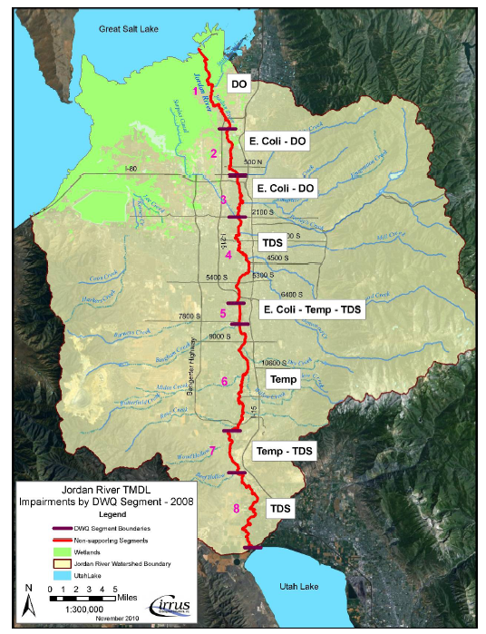
BACKGROUND
Jordan River
51 mile stretch
Public perception and use
Impairment
Fish
Notes:
DO impairs "these" three segments near the outlet of the Jordan River to the Great Salt Lake.

Slide 4
WEAP: Data Requirements
Catchments | River | Water Quality
Area | Length | Water Temperature
Crop Coefficient | Flow-Stage-Width Curve | BOD
Effective Precipitation
Precipitation

Slide 5



DATA COLLECTION
Notes:
Udot data was obtained through work contacts

Slide 6
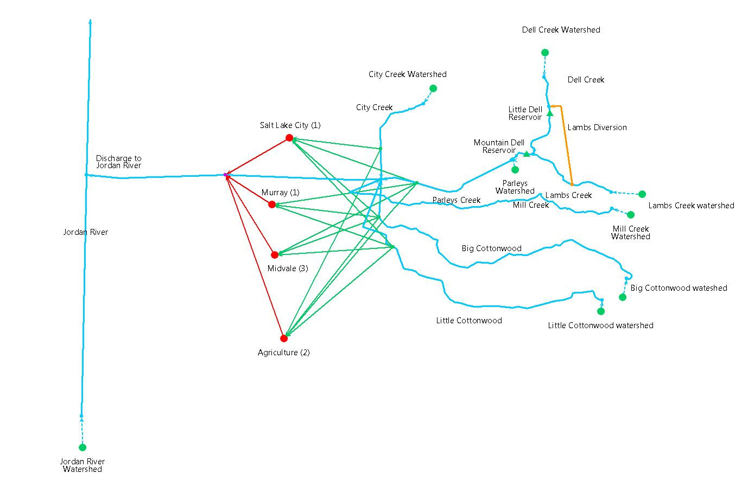
SCHEMATIC
8 Catchments
8 Rivers
2 Reservoirs
1 Diversion
4 Demand Nodes

Slide 7
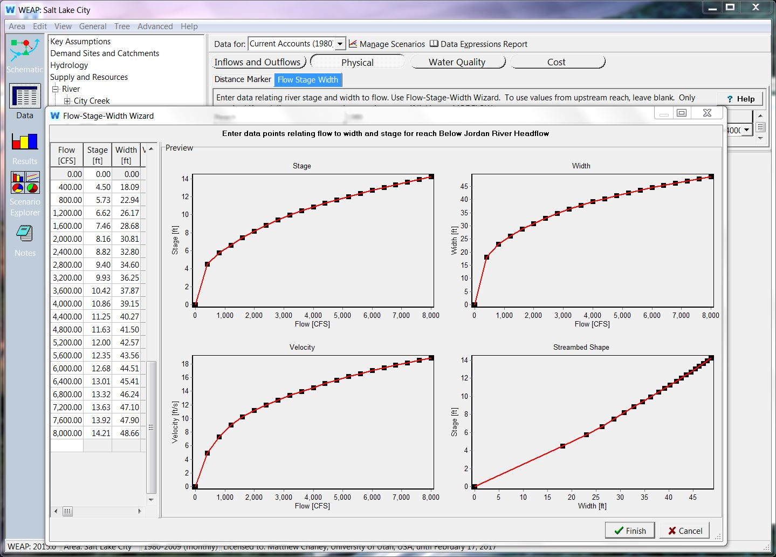
CHANNEL GEOMETRY
Flow-Stage-Width Curve
UDOT
Hydraulic Toolbox
Notes:
Bridge cross sections from UDOT

Slide 8
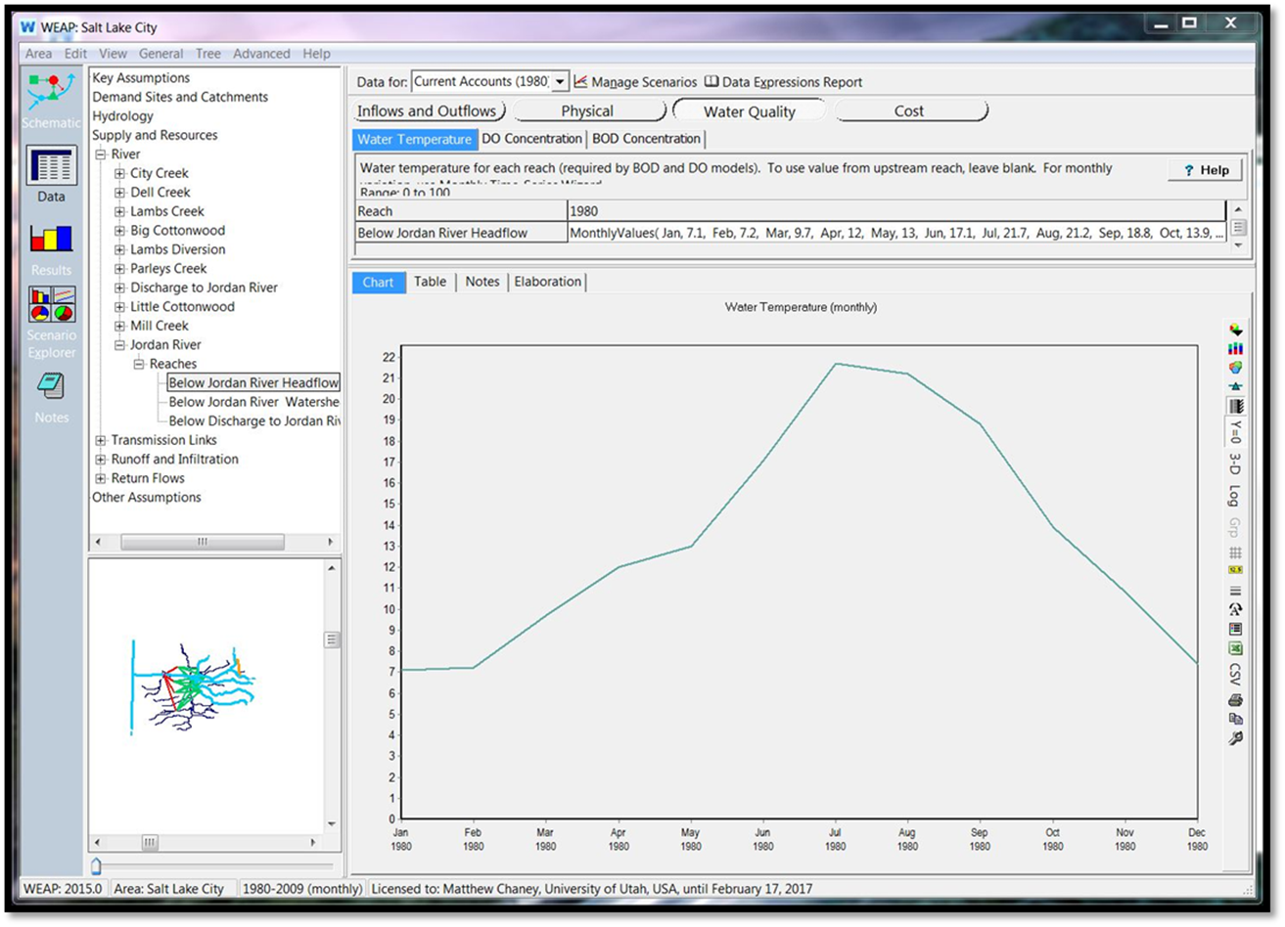
WATER TEMP
TMDL Data
Monthly
Historic Climate Data
Notes:
Currently just average monthly data from the TMDL
We would like to obtain more climate data and use that, then project it into the future along with population projections

Slide 9
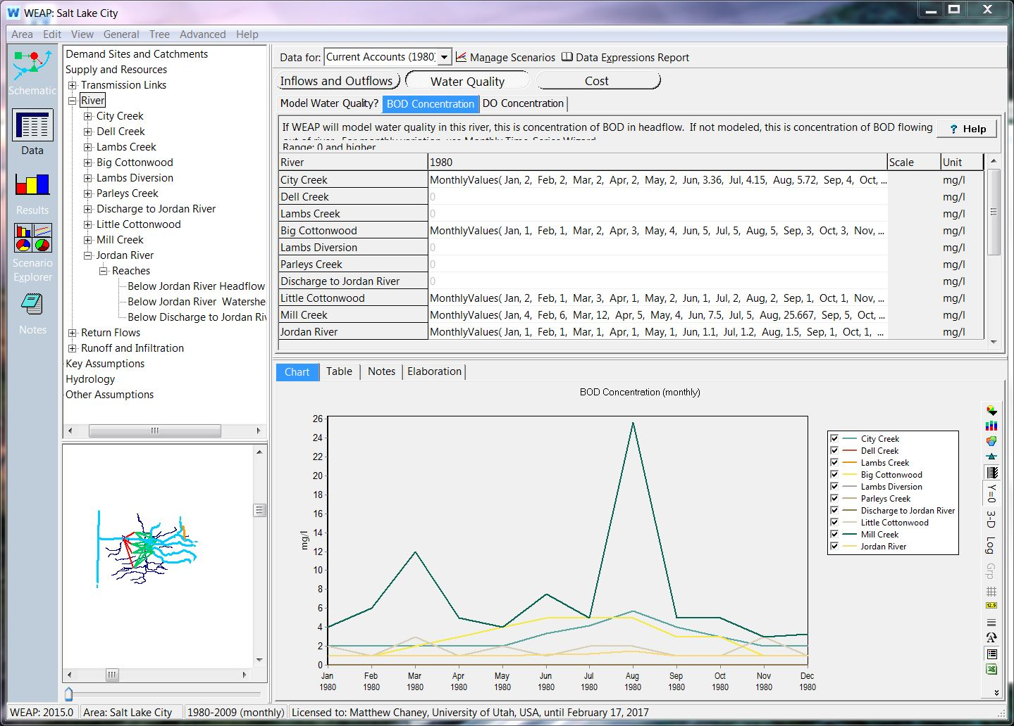
BOD
AWQMS
Modeled 5 of 8 streams

Slide 10
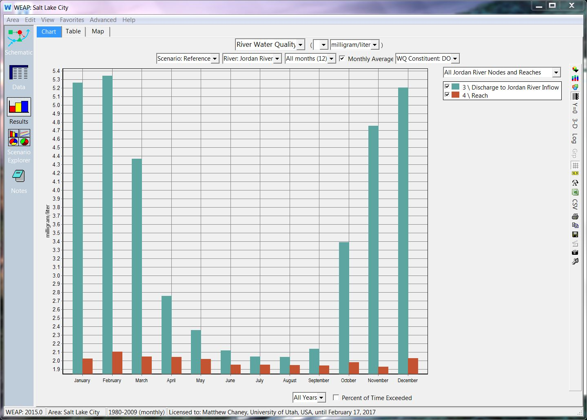
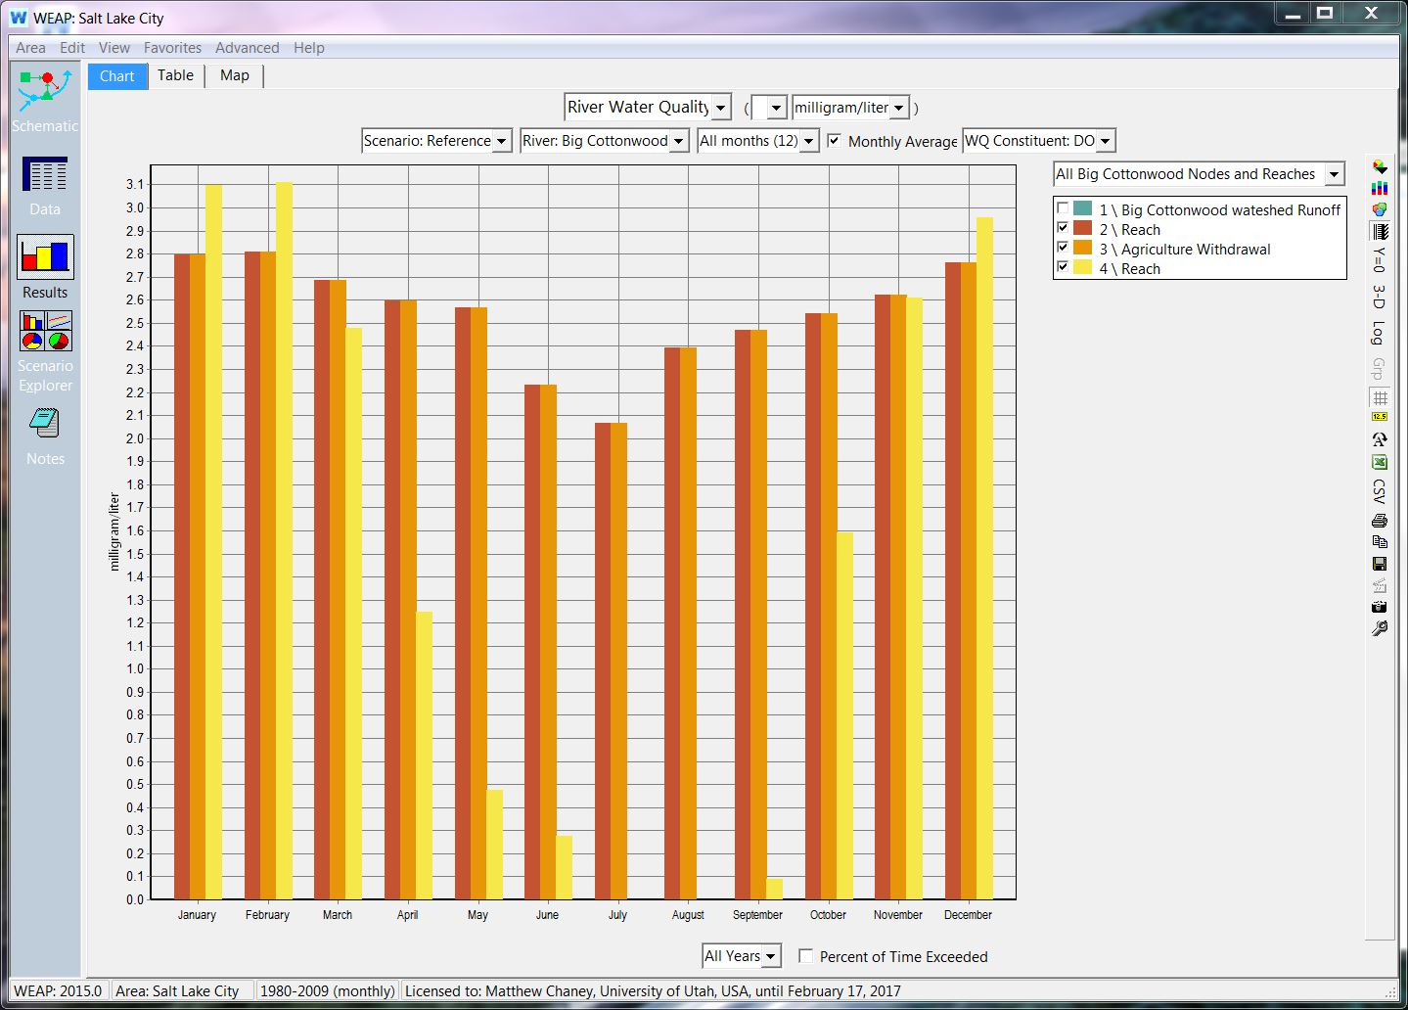
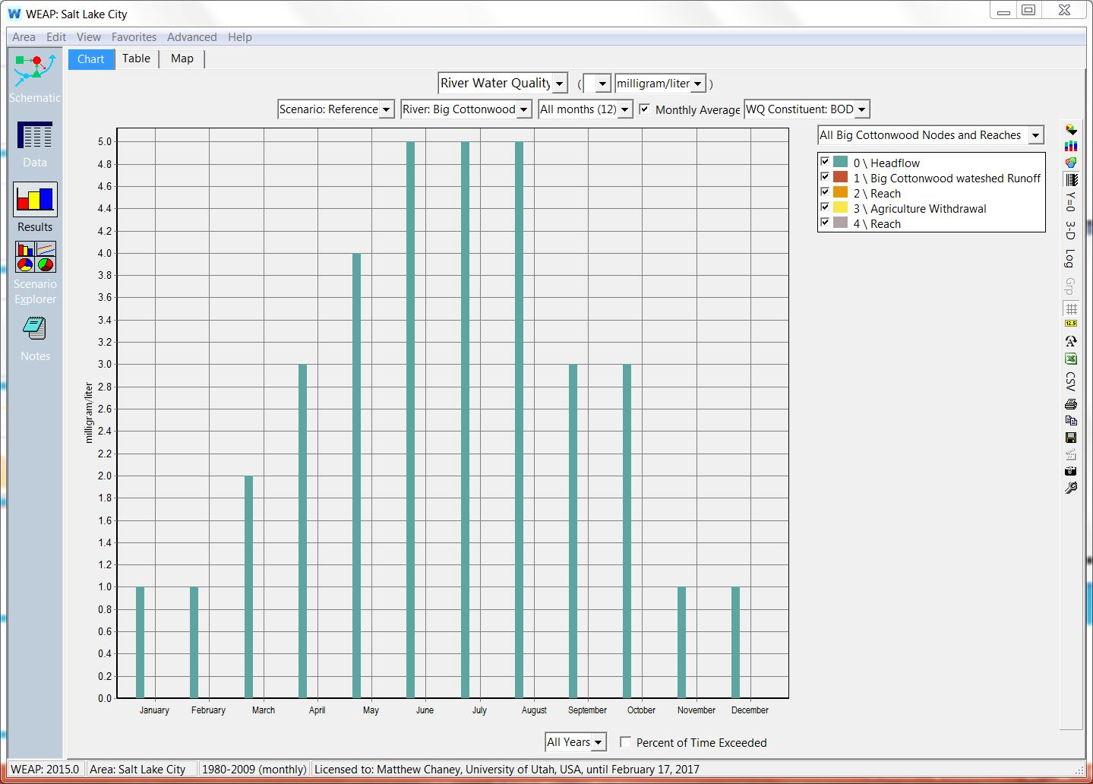
RESULTS
Notes:
Left is the BOD for Big Cottonwood
Right is DO Big Cottonwood

Slide 11
Questions?

Slide 12
REFERENCES
Ambient Water Quality Monitoring System (AWQMS) User Guide. N.p.: Goldsystems, 18 June 2013. PDF.
Goharian, Erfan, Class 24: Create a WEAP Model. University of Utah. December 1, 2015.
Jordan River Total Maximum Daily Load Water Quality Study - Phase 1. Logan, Utah: Cirrus Ecological Solutions, LC, 5 June 2013. PDF.
Salt Lake City County. "Blueprint Jordan River." Blueprint Jordan River. Salt Lake City County, Dec. 2008. Web. 01 Mar. 2016. <http://www.slco.org/blueprint/>.
Salt Lake City County. "Watershed Planning and Restoration Program." Water Quality. Salt Lake City County, n.d. Web. 01 Mar. 2016. <http://slco.org/watershed/wtrQual/wqBenificial.html>.
Sieber, Jack, and David Purkey. Water Evaluation And Planning System User Guide. Somerville, MA: Stockholm Environment Institute, U.S. Center, Aug. 2015. PDF.

